Slide 1
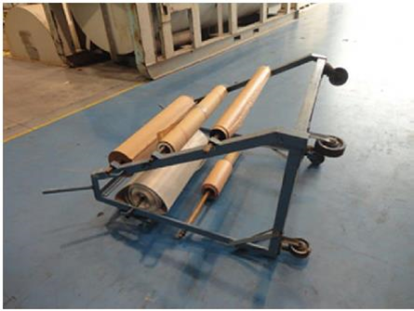
HS&E INCIDENT BULLETIN |  | 1st half year 2016
Tulsa, Oklahoma | Type of incident (Arm Strain - Manual Material Handling)
Summary:
The injured person stated that he was rolling a paper roll storage cart to his work station. During transport, the 238 lb. (108 kg) cart began to tip and the employee reached out to stop the cart with his left arm. As a result, the employee sustained a strain injury to his left bicep.
Root Causes: | Actions Taken Thus Far: Next Steps
Cart was top-heavy. Cart was manufactured in-house. Tipping potential not evaluated. No formal strategy for evaluation and approval of tools and equipment that are made in-house. | Evaluate carts throughout repair centers for standard designs and labeling requirements. Evaluate items and establish approval process of items manufactured in-house if items can not be purchased. Update shop audit form for review of fixtures/items that have been manufactured in-house. Provide guidance on individual material handling capacities and when to use the buddy system.

